Slide 1
Sound and Waves

Slide 2
What is sound?*
Sound begins with a vibration.
Sounds travel in waves through a medium.

Slide 3
What is a wave?*
Energy is transferred through a wave.
Mechanical waves- travel through a medium
Electromagnetic waves- do not need a medium to travel
Can you think of examples of each?
Which one does this picture represent?
Sound waves are mechanical because they need a medium to travel.

Slide 4
Mechanical Waves*
Longitudinal Waves
The motion of the medium is parallel to the motion of the wave
Back and Forth Waves
**Sound Waves**
Transverse Waves
The motion of the medium is perpendicular to the motion of the wave
Up and Down Waves

Slide 5
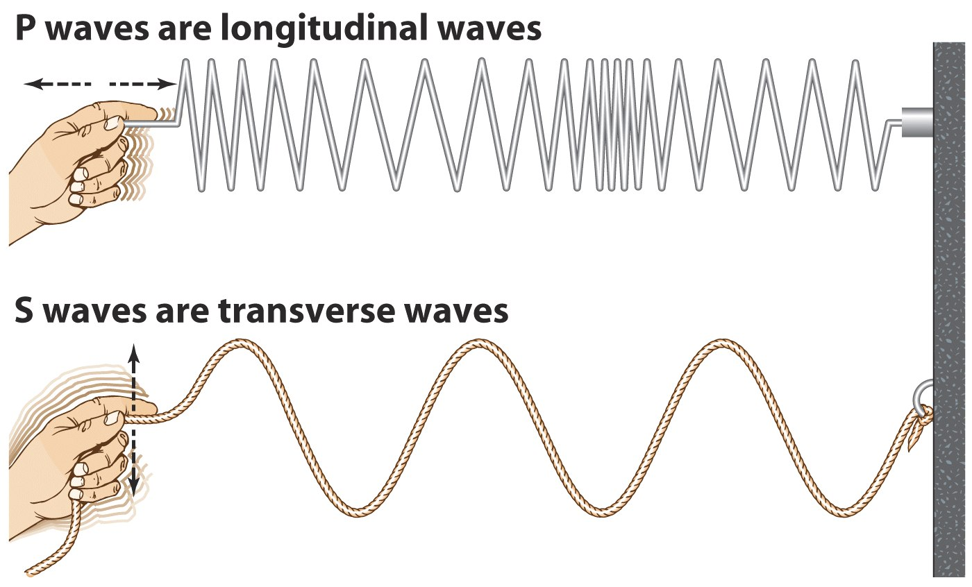
Another View

Slide 6
Longitudinal Waves*
Compression
When waves are close together
Rarefaction
When waves are far apart

Slide 7
Transverse Waves*
Crest- highest point on a wave
Amplitude- Volume of a wave (height of a wave)
As wave height increases, volume increases
Measured in Decibels
Trough- lowest point on a wave
Frequency- Pitch, high or low (length of a wave)
As wavelength increases, pitch decreases
Measured in Hertz

Slide 8
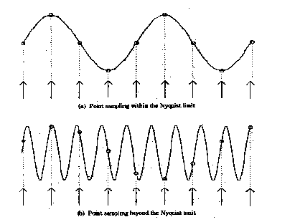
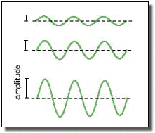
Amplitude versus Frequency
Amplitude
Which one will have the higher volume?
Frequency
Which one will have the higher pitch?

Slide 9
What can you hear?
Decibels (dB): Volume
Normal Speech: 60dB
Library: 40dB
Close Whisper: 20dB
Jet Engine: 140dB
Loud Rock Music: 110dB
Subway Train: 100dB
Busy Street Traffic: 70dB
120dB or above usually causes pain to the ear
Hertz (Hz): Pitch
Young people can hear frequencies between 20-20,000 Hz
Dogs can hear frequencies that range from 67-45,000 Hz
As you age, your ability to hear high frequency sound decreases.

Slide 10
Now you will create a diagram for the parts of a wave.
Use string and tape.
An example is on the next slide.

Slide 11
Diagram of a Transverse Wave*
AMPLITUDE
CREST
TROUGH
WAVELENGTH

